Slide 1
NMHU Cluster

Slide 2
Secure Shell(SSH) Terminal
Open CMD/Terminal
ssh NMHUCovidResearch@nmhucluster.duckdns.org -p 25000
“hsci282”
WARNING
After 2 wrong password attempts or any activity the server recognizes as suspicious you will be banned.

Slide 3
Secure Copy(scp)
Limit your SCP’s to 2GB.
Copy to /mnt/2TB

Slide 4
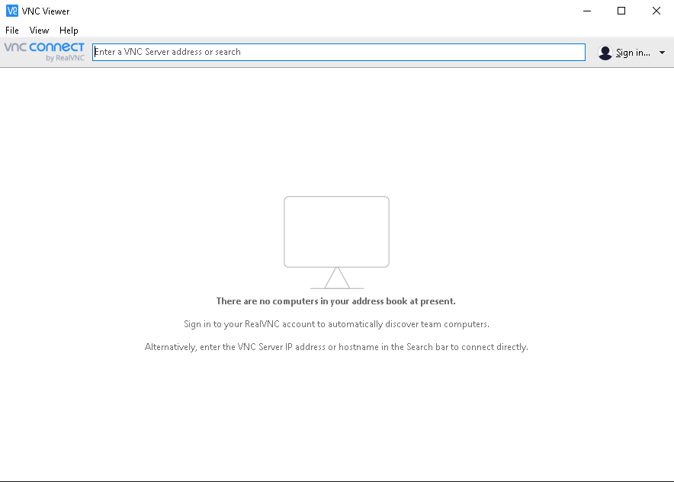
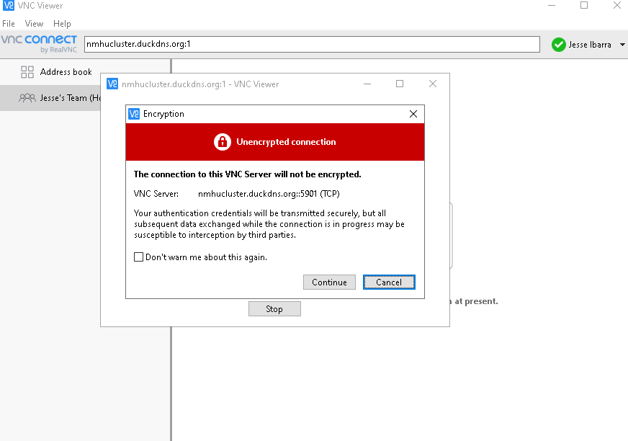
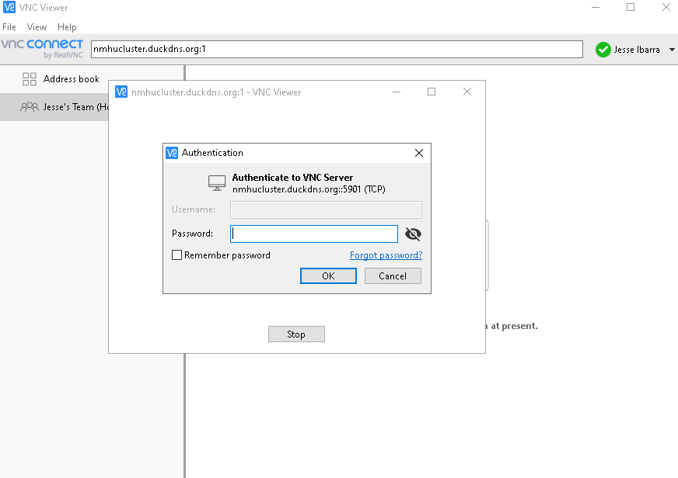
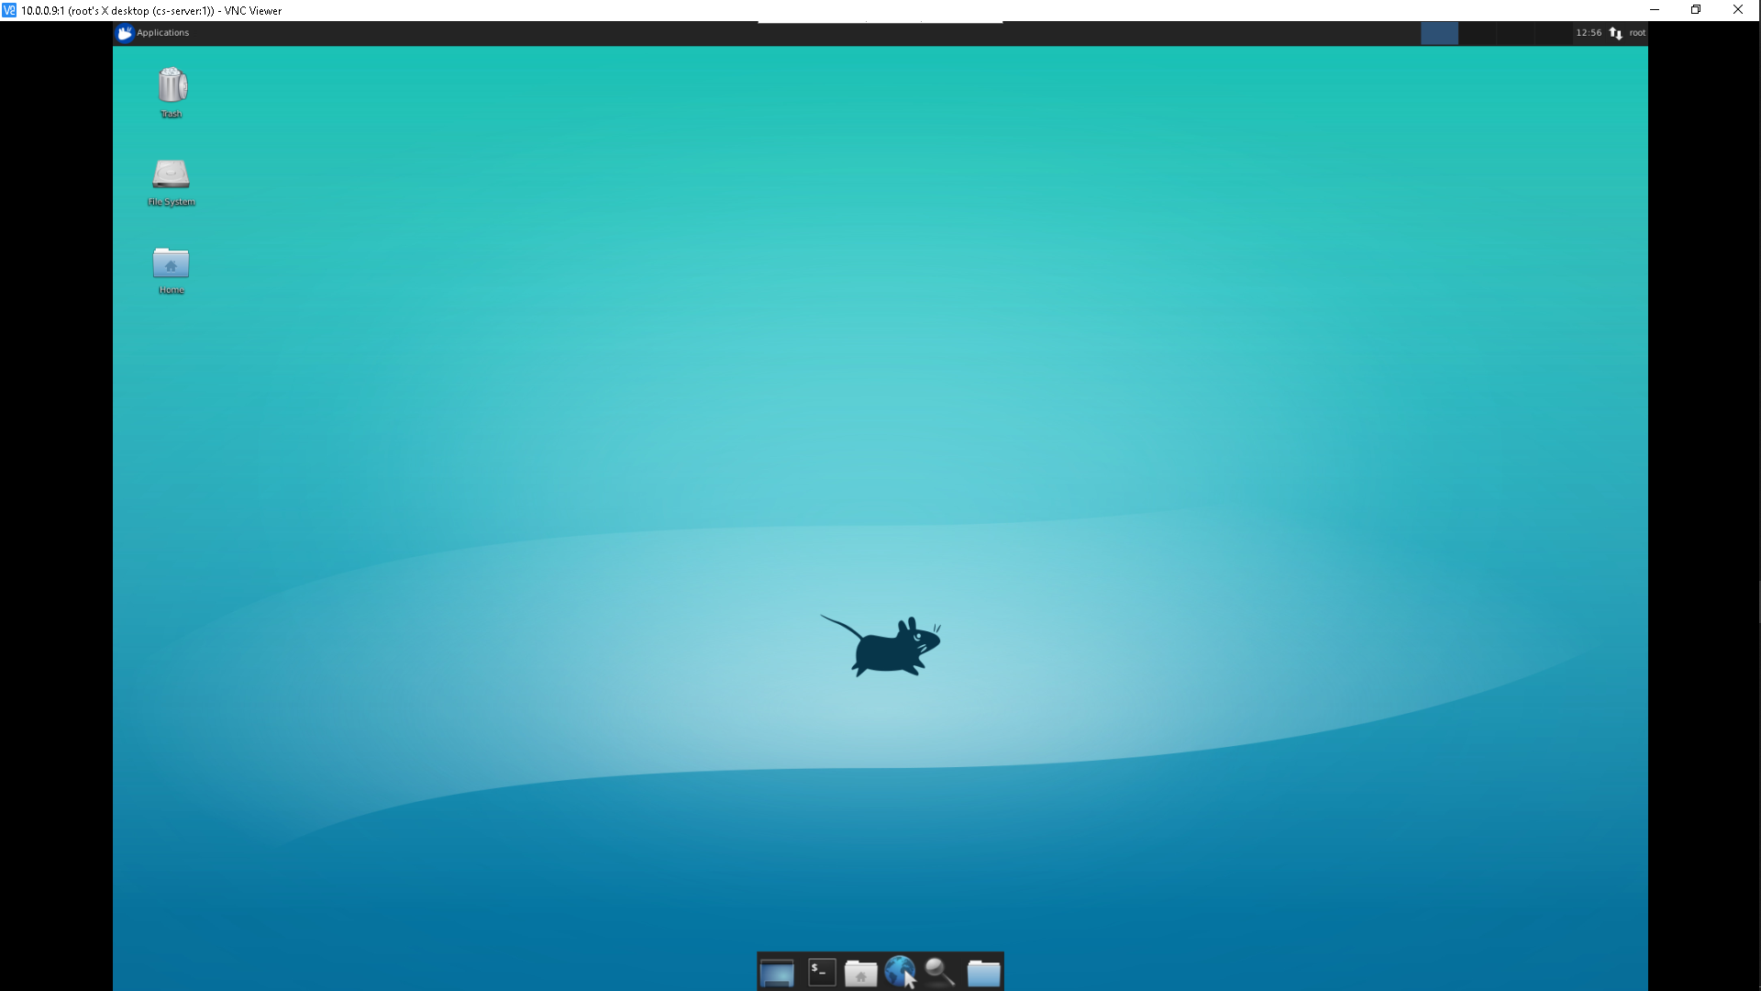
Linux Remote Desktop Access (VNC Server)

